Slide 1
Chapter 9:
Characters, Strings, and the string class
Brief Version of Starting Out with C++, 5/e
by Tony Gaddis and Barret Krupnow

Slide 2
9.1
Character Testing

Slide 3
Character Testing
require cctype header file
FUNCTION | MEANING
isalpha | true if arg. is a letter, false otherwise
isalnum | true if arg. is a letter or digit, false otherwise
isdigit | true if arg. is a digit 0-9, false otherwise
islower | true if arg. is lowercase letter, false otherwise
isprint | true if arg. is a printable character, false otherwise
ispunct | true if arg. is a punctuation character, false otherwise
isupper | true if arg. is an uppercase letter, false otherwise
isspace | true if arg. is a whitespace character, false otherwise

Slide 4
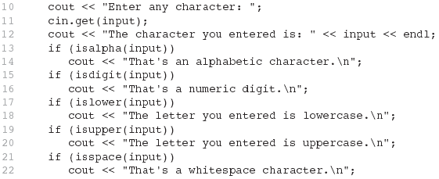
From Program 9-1

Slide 5
9.2
Character Case Conversion

Slide 6
Character Case Conversion
Require cctype header file
Functions:
  toupper: if char argument is lowercase letter, return uppercase equivalent; otherwise, return input unchanged
  char ch1 = 'H';
  char ch2 = 'e';
  char ch3 = '!';
  cout << toupper(ch1); // displays 'H'
  cout << toupper(ch2); // displays 'E'
  cout << toupper(ch3); // displays '!'

Slide 7
Character Case Conversion
Functions:
  tolower: if char argument is uppercase letter, return lowercase equivalent; otherwise, return input unchanged
  char ch1 = 'H';
  char ch2 = 'e';
  char ch3 = '!';
  cout << tolower(ch1); // displays 'h'
  cout << tolower(ch2); // displays 'e'
  cout << tolower(ch3); // displays '!'

Slide 8
9.3
Review of the Internal Storage of C-Strings

Slide 9
Review of the Internal Storage of C-Strings
C-string: sequence of characters stored in adjacent memory locations and terminated by NULL character
String literal (string constant): sequence of characters enclosed in double quotes " " : "Hi there!"
H
i
t
h
e
r
e
!
\0

Slide 10
Review of the Internal
Storage of C-Strings
Array of chars can be used to define storage for string:
const int SIZE = 20;
char city[SIZE];
Leave room for NULL at end
Can enter a value using cin or >>
  Input is whitespace-terminated
  No check to see if enough space
For input containing whitespace, and to control amount of input, use cin.getline()

Slide 11
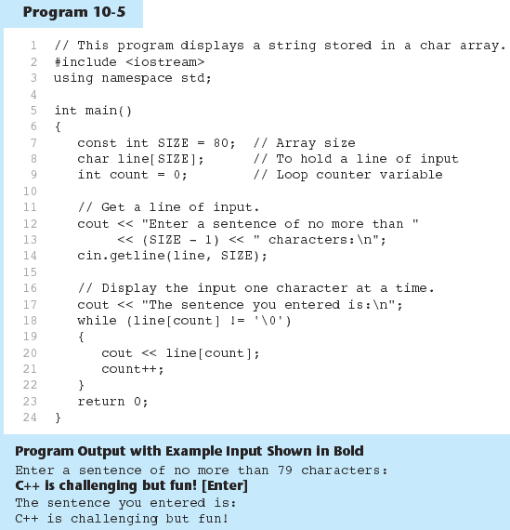
Program 9-5

Slide 12
9.4
Library Functions for Working with C-Strings

Slide 13
Library Functions for Working with C-Strings
Require the cstring header file
Functions take one or more C-strings as arguments. Can use:
  C-string name
  pointer to C-string
  literal string

Slide 14
Library Functions for
Working with C-Strings
Functions:
  strlen(str): returns length of C-string str
    char city[SIZE] = "Missoula";
    cout << strlen(city); // prints 8
  strcat(str1, str2): appends str2 to the end of str1
    char location[SIZE] = "Missoula, ";
    char state[3] = "MT";
    strcat(location, state);
    // location now has "Missoula, MT"

Slide 15
Library Functions for
Working with C-Strings
Functions:
  strcpy(str1, str2): copies str2 to str1
  const int SIZE = 20;
  char fname[SIZE] = "Maureen", name[SIZE];
  strcpy(name, fname);
  Note: strcat and strcpy perform no bounds checking to determine if there is enough space in receiving character array to hold the string it is being assigned.

Slide 16
C-string Inside a C-string
Function:
  strstr(str1, str2): finds the first occurrence of str2 in str1. Returns a pointer to match, or NULL if no match.
    char river[] = "Wabash";
    char word[] = "aba";
    cout << strstr(state, word);
    // displays "abash"

Slide 17
9.5
String/Numeric Conversion Functions

Slide 18
String/Numeric Conversion Functions
require cstdlib header file
FUNCTION | PARAMETER | ACTION
atoi | C-string | converts C-string to an int value, returns the value
atol | C-string | converts C-string to a long value, returns the value
atof | C-string | converts C-string to a double value, returns the value
itoa | int,C-string, int | converts 1st int parameter to a C-string, stores it in 2nd parameter. 3rd parameter is base of converted value

Slide 19
String/Numeric Conversion Functions
int iNum;
long lNum;
double dNum;
char intChar[10];
iNum = atoi("1234"); // puts 1234 in iNum
lNum = atol("5678"); // puts 5678 in lNum
dNum = atof("35.7"); // puts 35.7 in dNum
itoa(iNum, intChar, 8); // puts the string
// "2322" (base 8 for 1234₁₀) in intChar

Slide 20
String/Numeric Conversion Functions - Notes
if C-string contains non-digits, results are undefined
  function may return result up to non-digit
  function may return 0
itoa does no bounds checking – make sure there is enough space to store the result

Slide 21
9.6
Writing Your Own C-String Handling Functions

Slide 22
Writing Your Own C-String Handling Functions
Designing C-String Handling Functions
  can pass arrays or pointers to char arrays
  Can perform bounds checking to ensure enough space for results
  Can anticipate unexpected user input

Slide 23
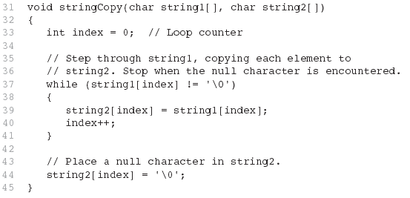
From Program 9-9

Slide 24
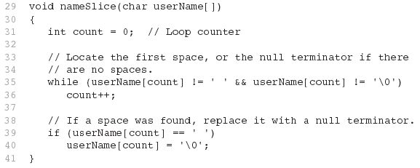
From Program 9-10

Slide 25
9.7
The C++ string Class

Slide 26
The C++ string Class
Special data type supports working with strings
#include <string>
Can define string variables in programs:
  string firstName, lastName;
Can receive values with assignment operator:
  firstName = "George";
  lastName = "Washington";
Can be displayed via cout
  cout << firstName << " " << lastName;

Slide 27
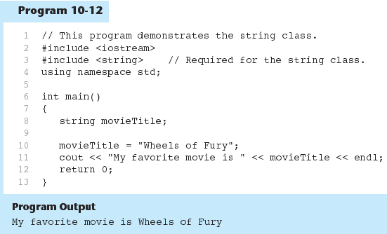
Program 9-12

Slide 28
Input into a string Object
Use cin >> to read an item into a string:
  string firstName;
  cout << "Enter your first name: ";
  cin >> firstName;

Slide 29
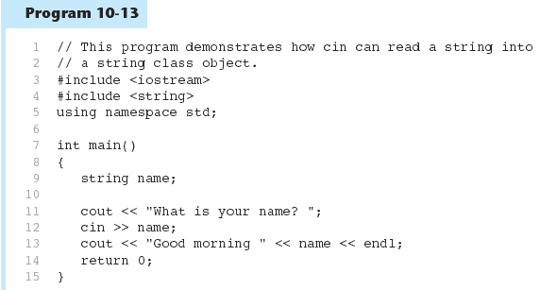
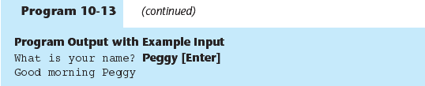
Program 9-13
Program 9-13 Continued

Slide 30
Input into a string Object
Use getline function to put a line of input, possibly including spaces, into a string:
  string address;
  cout << "Enter your address: ";
  getline(cin,address);

Slide 31
string Comparison
Can use relational operators directly to compare string objects:
  string str1 = "George",
  str2 = "Georgia";
  if (str1 < str2)
  cout << str1 << " is less than "
  << str2;
Comparison is performed similar to strcmp function. Result is true or false

Slide 32
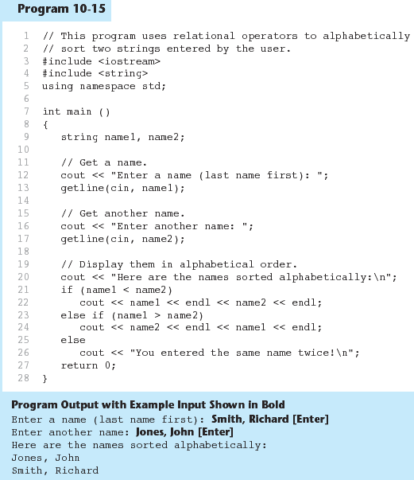
Program 9-15

Slide 33
Other Definitions of C++ strings
Definition | Meaning
string name; | defines an empty string object
string myname("Chris"); | defines a string and initializes it
string yourname(myname); | defines a string and initializes it
string aname(myname, 3); | defines a string and initializes it with first 3 characters of myname
string verb(myname,3,2); | defines a string and initializes it with 2 characters from myname starting at position 3
string noname('A', 5); | defines string and initializes it to 5 'A's

Slide 34
string Operators
OPERATOR | MEANING
>> | extracts characters from stream up to whitespace, insert into string
<< | inserts string into stream
= | assigns string on right to string object on left
+= | appends string on right to end of contents on left
+ | concatenates two strings
[] | references character in string using array notation
>, >=, <, <=, ==, != | relational operators for string comparison. Return true or false

Slide 35
string Operators
string word1, phrase;
string word2 = " Dog";
cin >> word1; // user enters "Hot Tamale"
// word1 has "Hot"
phrase = word1 + word2; // phrase has
// "Hot Dog"
phrase += " on a bun";
for (int i = 0; i < 16; i++)
cout << phrase[i]; // displays
// "Hot Dog on a bun"

Slide 36
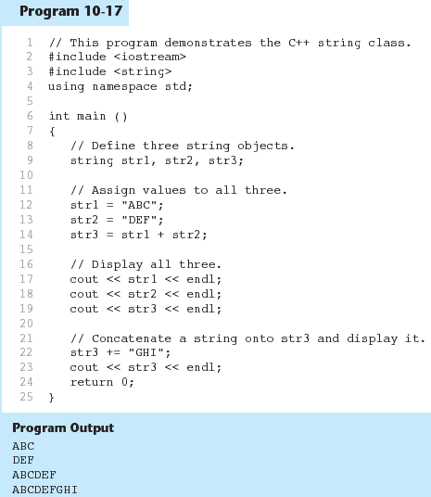
Program 9-17

Slide 37
string Member Functions
Are behind many overloaded operators
Categories:
  assignment: assign, copy, data
  modification: append, clear, erase, insert, replace, swap
  space management: capacity, empty, length, resize, size
  substrings: find, substr
  comparison: compare
See Table 9-7 for a list of functions

Slide 38
string Member Functions
string word1, word2, phrase;
cin >> word1; // word1 is "Hot"
word2.assign(" Dog");
phrase.append(word1);
phrase.append(word2); // phrase has "Hot Dog"
phrase.append(" with mustard relish", 13);
// phrase has "Hot Dog with mustard"
phrase.insert(8, "on a bun ");
cout << phrase << endl; // displays
// "Hot Dog on a bun with mustard"

Slide 39
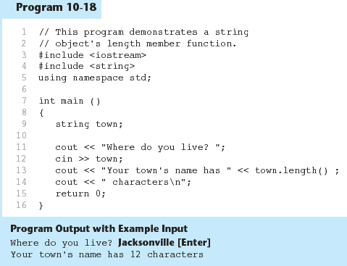
Program 9-18

